Slide 1
Catchy
Desktop Log Viewer for Embedded and Android Debugging
A unified platform for log analysis and real-time logcat monitoring
Designed for large-scale log files, structured filtering, and workflow optimization
Improves debugging speed, traceability, and usability compared with manual inspection
Catchy
Log viewer
Live stream
Search
Bookmark
Screen Copy

Slide 2
Problem Statement
Limitations of the Existing Tool
Large log files are difficult to process efficiently without noticeable delays
Search and filtering operations are insufficient for rapid debugging workflows
The user must switch contexts between viewing logs and monitoring device activity
Important events are harder to trace and revisit during repeated debugging cycles
The existing workflow does not support smooth live investigation and structured analysis
Bonnibel.exe
Limited workflow
Slower triage

Slide 3
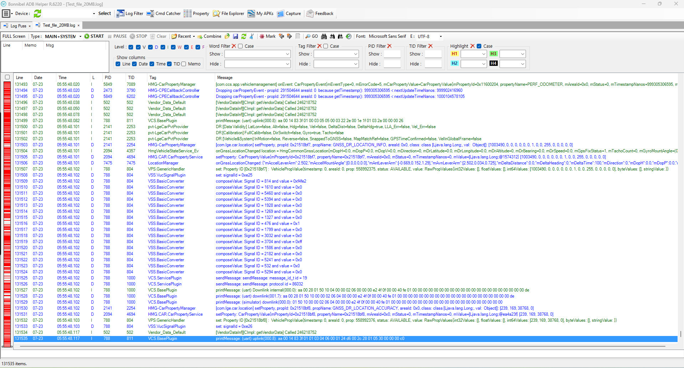
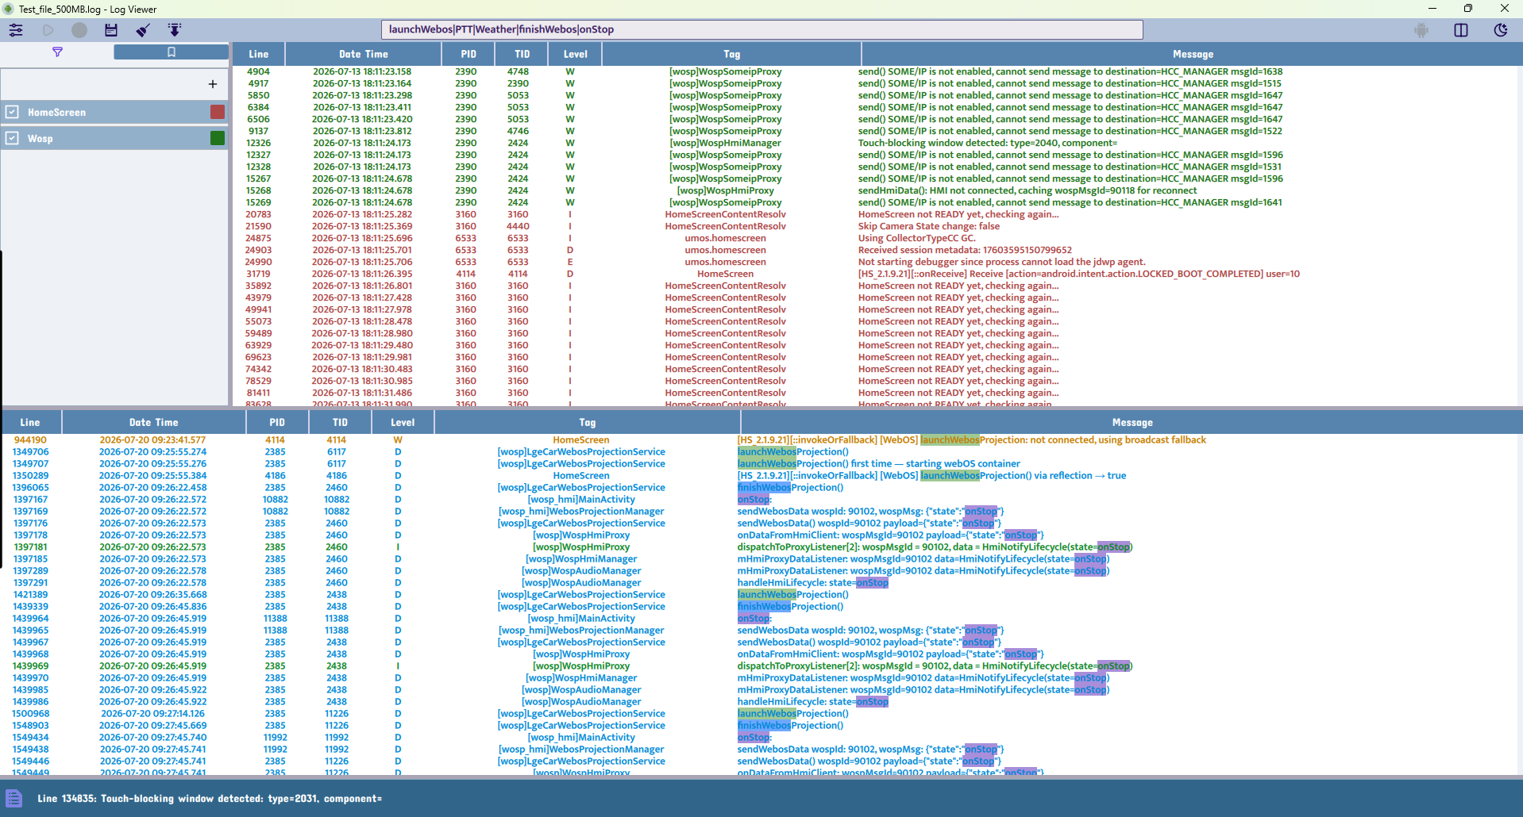
Comparative Evidence
Legacy Tool Versus Proposed System
The updated interface demonstrates a clearer layout, reduced operational friction, and a more efficient debugging workflow.

Slide 4
Performance Evaluation
Measured Loading-Time Comparison
File size | Catchy | Bonnibel.exe
20 MB | under 2s | under 2s
100 MB | 3s | 9s
250 MB | 6s | 20s
500 MB | 12s | 45s / occasional UI freeze
Result: Catchy maintains responsiveness even with large log files, whereas the legacy tool experiences noticeable delays.

Slide 5
Evidence of Improvement
Major Bottleneck Reduction and Enhanced Usability
500MB logs load in approximately 12 seconds in Catchy, compared with about 45 seconds and occasional UI freezing in Bonnibel
The adaptive interface maintains responsiveness while streaming live logcat data
Automatic ADB state detection reduces user errors and improves operational reliability
Keyboard shortcuts and workflow automation significantly reduce manual navigation and debugging effort
The system now supports continuous monitoring with a 500MB retention window and smooth scrolling performance

Slide 6
System Architecture
QML UI
Controller
Log Model
Filters
Search
Bookmark
The application follows an MVVM-inspired structure with worker threads to support large-file loading and live streaming.
The controller coordinates the core logic, while the QML layer ensures responsive visual updates and efficient user interaction.

Slide 7
Core Functional Features
Large-file processing with progress indicators and worker-thread execution
Live logcat streaming with auto-scroll and real-time refresh
Multi-keyword highlighting using color-coded matching for rapid analysis
Named filters for process and tag-based debugging workflows
Bookmark system for saving and revisiting critical log entries
Scrcpy integration for device-side visual verification and validation

Slide 8
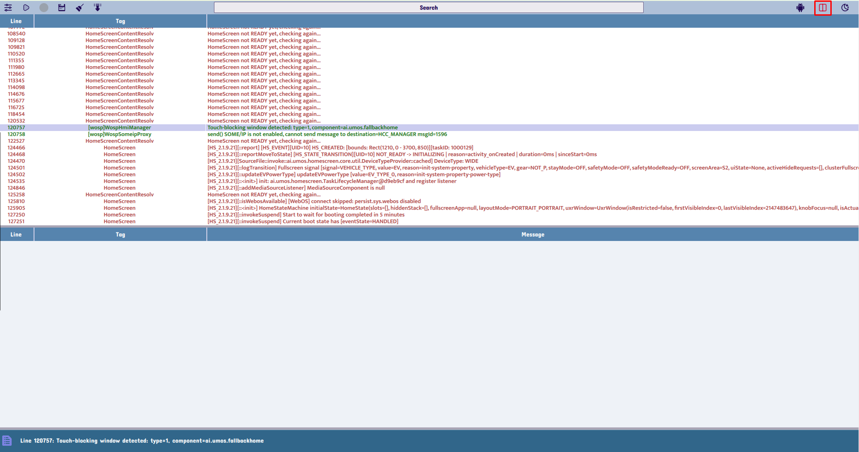
Full Log Viewer UI
Main view with log table and filtering controls
The full log viewer provides a readable, structured interface for large logs, making analysis more efficient than a text-heavy legacy tool.

Slide 9
Long Search Box
Quick keyword search and result navigation
A dedicated search bar enables fast keyword search, better visibility, and quick navigation to relevant log entries
Show the hint of the history whey typing the work to search

Slide 10
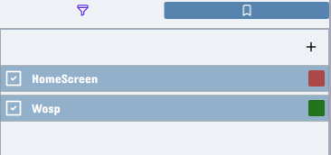
Tag Filter Panel
Color-coded tag and process filtering
Named filters and color coding make it easy to isolate important processes and reduce noise in large log sets.

Slide 11
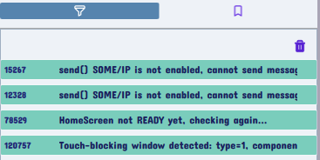
Tag Filter and Bookmark Panel
Filter management and bookmark workflow
The left-side panels allow users to monitor active filters and bookmarks without leaving the main debugging context, click to jump to the line of the bookmark
Click the bookmark to jump the line is marked and see around source code

Slide 12
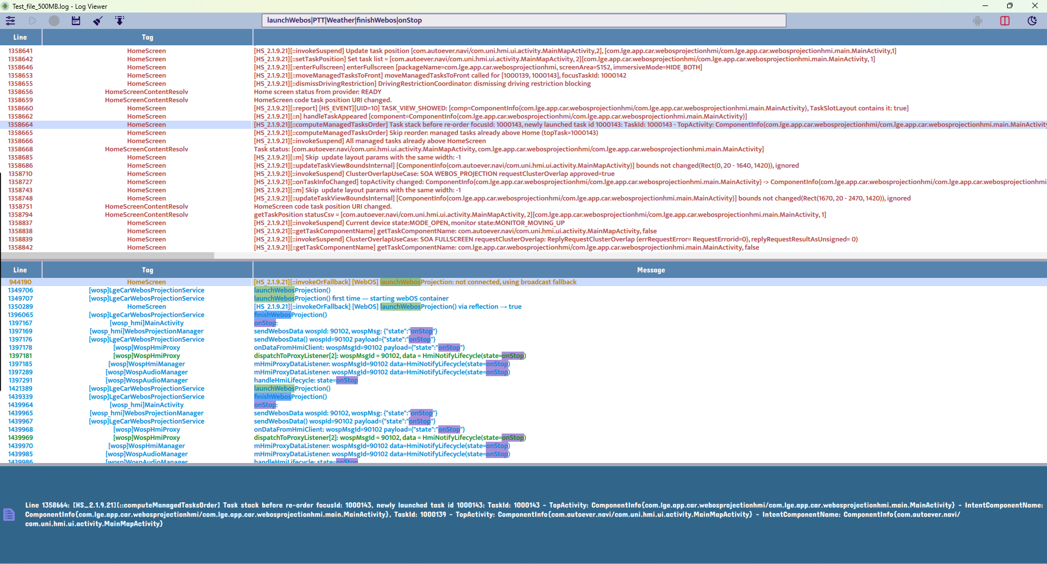
Split View for Long Content
Readable handling of expanded log content
The split layout keeps long line content readable and avoids the cramped interface that makes debugging difficult.
Search with two layers: First search by tag, then search by word based on data are searched by tag

Slide 13
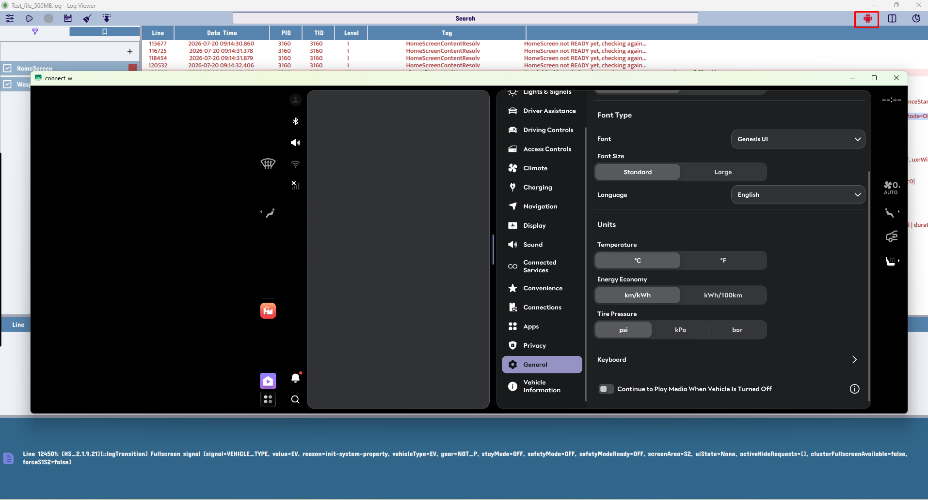
Auto-enable Scrcpy
Smart device integration
When the device is connected, the app automatically enables the screen-copy workflow for a smoother live debugging experience.

Slide 14
User Experience and Workflow Optimization
Automation and Shortcut-Based Efficiency
Automatically enables Start Stream Logcat and Start Screen Copy when an ADB device is connected
Automatically disables the same actions when no compatible device is available
Keyboard shortcuts accelerate the debugging workflow:
Ctrl+F search, Ctrl+B columns, Ctrl+T filter edit,
Ctrl+M bookmark panel, Ctrl+P auto-scroll
Smooth scrolling, drag-to-open file handling, and an efficient side-panel layout reduce friction during analysis
A 500MB retention window preserves recent activity and supports continuous live monitoring without losing context

Slide 15
Testing & Validation
Validation area | Result
Large log loading | Responsive while reading and parsing huge files
Live stream | Stable updates and auto-scroll control
Filters | Fast matching and color grouping
Search | Highlight multiple keywords correctly
Bookmarks | Quick jump and persistence
UI behavior | Dark/light theme and table responsiveness
ADB device handling | Auto enable/disable based on connection state

Slide 16
Proof of the New UI and Features
Easy-to-use workflow and improved capability
The updated interface and feature set show a cleaner, more usable, and more efficient debugging workflow.

Slide 17
Conclusion
Project Outcome and Value Delivered
Catchy is a practical and user-centered log analysis tool for embedded and Android debugging workflows
It resolves key limitations in large-file handling, filtering efficiency, and repetitive manual operations
The solution improves real-world productivity through performance optimization, automation, and streamlined interaction design
The final result offers a cleaner, faster, and more reliable debugging workflow than the reference tool

